Slide 1
Requirement Analysis
System Analysis and Design methods – Whitten
– Chapter 6

Slide 2
Outline
Define system requirements
Understand the concept of requirements management.
Identify seven fact-finding techniques and characterize the advantages and disadvantages of each.
Describe a fact-finding strategy that will make the most of your time with end-users.

Slide 3
Introduction
Requirements discovery – the process and techniques used by systems analysts to identify or extract system problems and solution requirements from the user community.
System requirement – something that the information system must do or a property that it must have. Also called a business requirement.

Slide 4
Reasons for Investigating the Current System
Functionality is required in new system
Data must be migrated into new system
Technical documentation provides details of processing algorithms
Defects of existing system must be avoided
Parts of existing system may have to be kept
We need to understand the work of the users
Baseline information about the existing system helps set targets for the new one

Slide 5
Results of Incorrect Requirements
More cost.
Late delivery.
User dissatisfaction.
High maintenance and expansion cost.
Error prone system.
Reputation of the IT team.

Slide 6
Relative Cost to Fix an Error
Phase in which error discovered | Cost Ratio
Requirements | 1
Design | 3-6
Coding | 10
Development Testing | 15-40
Acceptance Testing | 30-70
Operation | 40-1000

Slide 7
Criteria to Define System Requirements
Consistent – not conflicting.
Complete – describes all possible input and responses.
Feasible – can be fulfilled with available resources and constraints.
Required – truly needed for the purpose of the system.
Accurate – stated correctly.
Traceable – directly map to the functions and features of the system.
Verifiable –can be demonstrated during testing.

Slide 8
The Process of Requirements Discovery
Problem discovery and analysis
Requirements discovery
Documenting and analyzing requirements
Requirements management

Slide 9
Ishikawa Diagram (Problem Discovery and Analysis)
The Ishikawa diagram is a graphical tool used to identify, explore, and depict problems and the causes and effects of those problems. It is often referred to as a cause-and-effect diagram or a fishbone diagram.
They resemble a fish skeleton, with the "ribs" representing the causes of an event and the final outcome appearing at the head of the skeleton.
The purpose of the Ishikawa diagram is to allow management to determine which issues have to be addressed in order to gain or avoid a particular event.

Slide 10
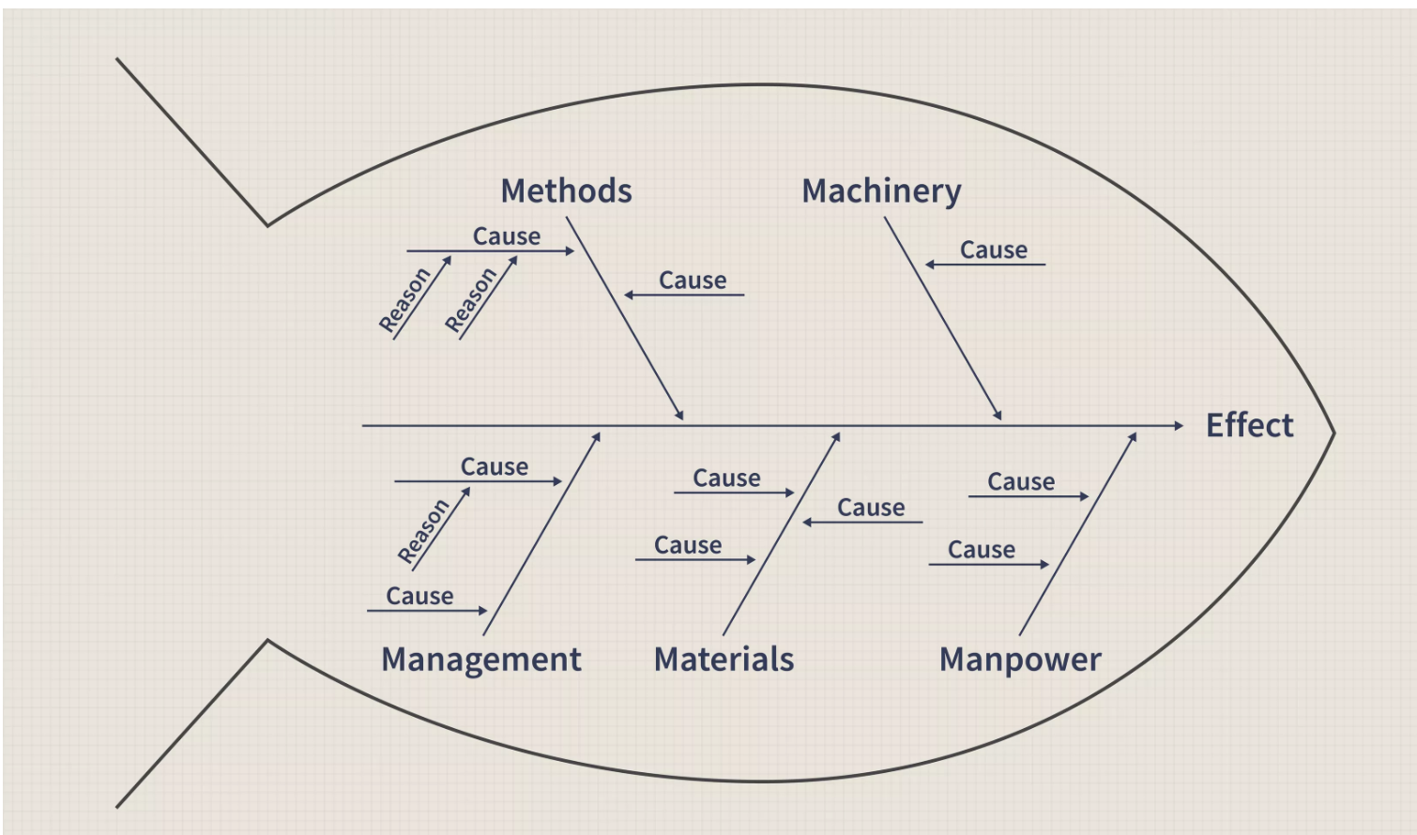
Ishikawa Diagram

Slide 11
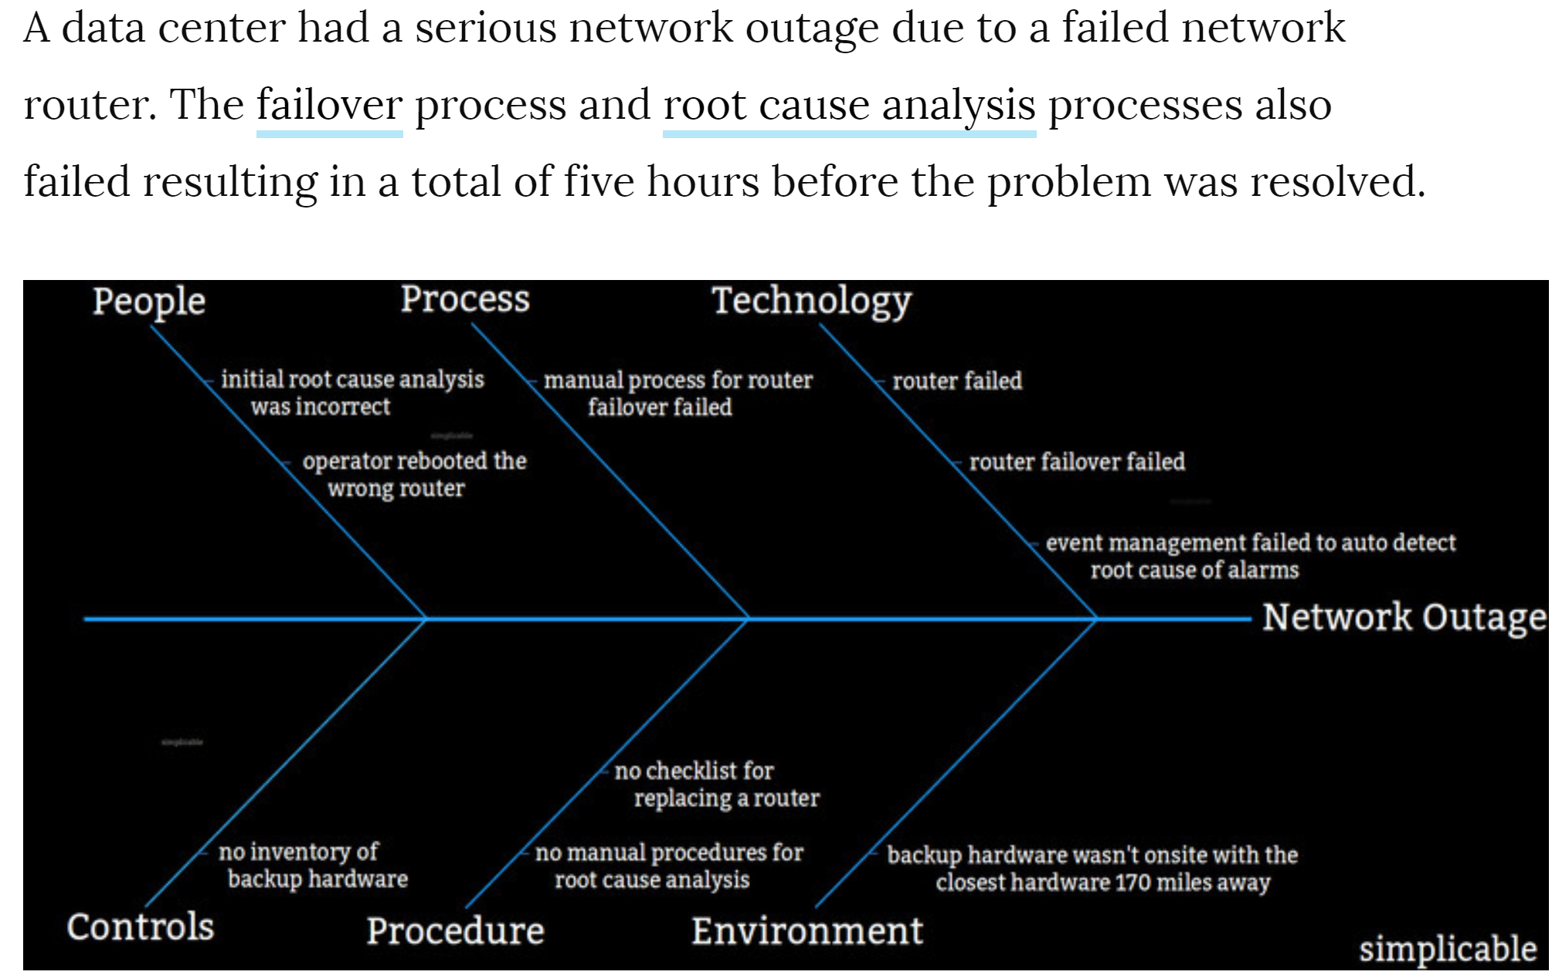
Ishikawa Diagram Example

Slide 12
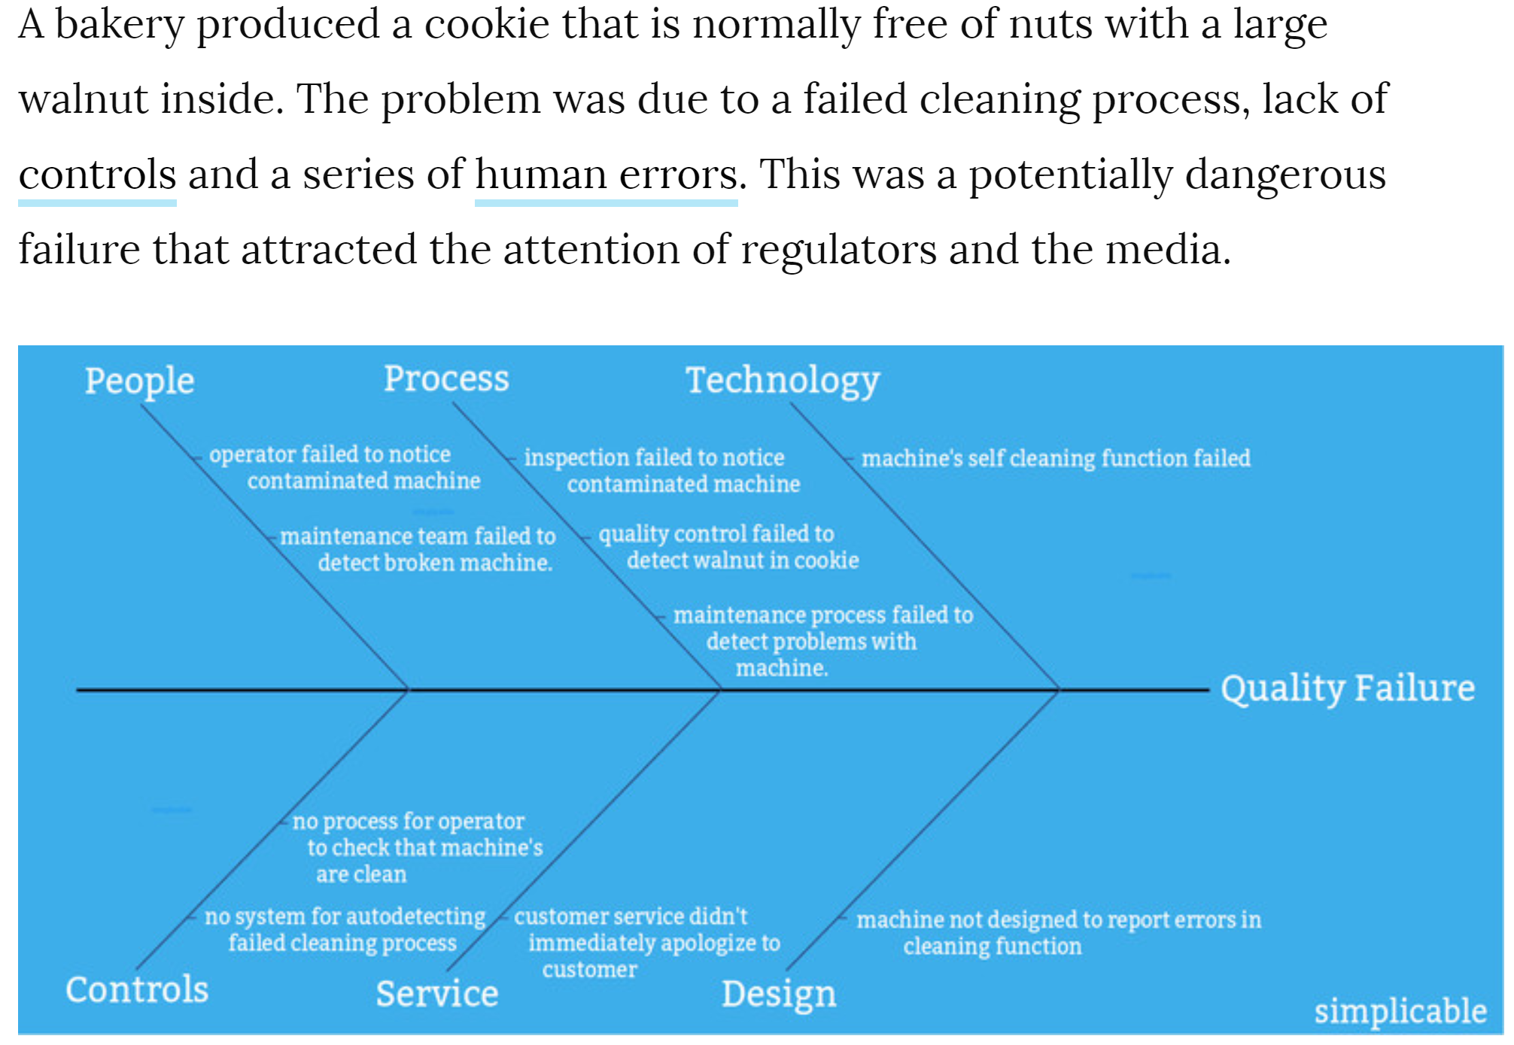
Ishikawa Diagram Example

Slide 13
Requirements Discovery
Given an understanding of problems, the systems analyst can start to define requirements.
Fact-finding – the formal process of using research, meetings, interviews, questionnaires, sampling, and other techniques to collect information about system problems, requirements, and preferences. It is also called information gathering or data collection.

Slide 14
Requirements Management
Requirements management - the process of managing change to the requirements.
Over the lifetime of the project it is very common for new requirements to emerge and existing requirements to change.
Studies have shown that over the life of a project as much as 50 percent or more of the requirements will change before the system is put into production.

Slide 15
Seven Fact‐Finding Methods
Background Research
Sampling of existing documentation, forms, and databases
Observation of the work environment
Questionnaires
Interviews
Prototyping
Joint requirements planning (JRP)

Slide 16
Background Reading
Aim is to understand the organization and its business objectives
Includes:
reports
organization charts
policy manuals
job descriptions
documentation of existing systems

Slide 17
Background Reading
Advantages:
helps to understand the organization before meeting the people who work there
helps to prepare for other types of fact finding
documentation of existing system may help to identify requirements for functionality of new system
Disadvantages:
written documents may be out of date or not match the way the organization really operates
Appropriate situations:
analyst is not familiar with organization
initial stages of fact finding

Slide 18
Seven Fact‐Finding Methods
Background Research
Sampling of existing documentation, forms, and databases
Observation of the work environment
Questionnaires
Interviews
Prototyping
Joint requirements planning (JRP)

Slide 19
Sampling of Existing Documentation, Forms, and Files
Sampling – the process of collecting a representative sample of documents, forms, and
records
Organization chart
Memos and other documents that describe the problem
Standard operating procedures for current system
Completed forms
Manual and computerized screens and reports
Samples of databases
Flowcharts and other system documentation

Slide 20
Sampling Documents
Advantages:
for gathering quantitative data
for finding out about error rates
Disadvantages:
not helpful if the system is going to change dramatically
Appropriate situations:
always used to understand information needs
where large volumes of data are processed
where error rates are high

Slide 21
Seven Fact‐Finding Methods
Background Research
Sampling of existing documentation, forms, and databases
Observation of the work environment
Questionnaires
Interviews
Prototyping
Joint requirements planning (JRP)

Slide 22
Observation
Observation – a fact-finding technique wherein the systems analyst either participates in or watches a person perform activities to learn about the system.
Work sampling - a fact-finding technique that involves a large number of observations taken at random intervals.

Slide 23
Observation Guidelines
Determine the who, what, where, when, why, and how of the observation.
Obtain permission from appropriate supervisors or managers.
Inform those who will be observed of the purpose of the observation.
Keep a low profile.
Take notes during or immediately following the observation.
Review observation notes with appropriate individuals.
Don't interrupt the individuals at work.
Don't focus heavily on trivial activities.
Don't make assumptions.

Slide 24
Observation
Advantages:
first-hand experience of how the system operates
high level of validity of the data can be achieved
verifies information from other sources
allows the collection of baseline data
Disadvantages:
people don’t like being observed and may behave differently, distorting the findings
requires training and skill
logistical problems for the analyst with staff who work shifts or travel long distances
ethical problems with personal data

Slide 25
Observation
Appropriate situations:
when quantitative data is required
to verify information from other sources
when conflicting information from other sources needs to be resolved
when a process needs to be understood from start to finish

Slide 26
Seven Fact‐Finding Methods
Background Research
Sampling of existing documentation, forms, and databases
Observation of the work environment
Questionnaires
Interviews
Prototyping
Joint requirements planning (JRP)

Slide 27
Questionnaires
Questionnaire – a special-purpose document that allows the analyst to collect information and opinions from respondents.
Free-format questionnaire – a questionnaire designed to offer the respondent greater latitude in the answer. A question is asked, and the respondent records the answer in the space provided after the question.
Fixed-format questionnaire – a questionnaire containing questions that require selecting an answer from predefined available responses.

Slide 28
Types of Fixed‐Format Questions
Multiple-choice questions
Rating questions
Ranking questions
Rank the following transactions according to the amount of time you spend processing them.
% new customer orders
% order cancellations
% order modifications
% payments
The implementation of quality discounts would cause an increase in customer orders.
Strongly agree Agree
No opinion Disagree Strongly disagree
Is the current accounts receivable report that you receive useful?
Yes No

Slide 29
Developing a Questionnaire
Determine what facts and opinions must be collected and from whom you should get them.
Based on the facts and opinions sought, determine whether free- or fixed-format questions will produce the best answers.
Write the questions.
Test the questions on a small sample of respondents.
Duplicate and distribute the questionnaire.

Slide 30
Questionnaire
Advantages:
economical way of gathering information from a large number of people
effective way of gathering information from people who are geographically dispersed
a well designed questionnaire can be analysed by computer
Disadvantages:
good questionnaires are difficult to design
no automatic way of following up or probing more deeply
postal questionnaires suffer from low response rates

Slide 31
Questionnaire
Appropriate situations:
when views of large numbers of people need to be obtained
when staff of organization are geographically dispersed
for systems that will be used by the general public and a profile of the users is required

Slide 32
Seven Fact‐Finding Methods
Background Research
Sampling of existing documentation, forms, and databases
Observation of the work environment
Questionnaires
Interviews
Prototyping
Joint requirements planning (JRP)

Slide 33
Interviews
Interview - a fact-finding technique whereby the systems analysts collect information from individuals through face-to-face interaction.
– Can be used to:
Find facts
Verify facts
Clarify facts
Generate enthusiasm
Get the end-user involved
The personal interview is generally recognized as the most important and most often
Identify requirements
Solicit ideas and opinions
used fact-finding technique.

Slide 34
Types of Interviews and Questions
Unstructured interview – an interview that is conducted with only a general goal or subject in mind and with few, if any, specific questions. The interviewer counts on the interviewee to provide a framework and direct the conversation.
Structured interview – an interview in which the interviewer has a specific set of questions to ask of the interviewee.
Open-ended question – question that allows the interviewee to respond in any way that seems appropriate.
Closed-ended question – a question that restricts answers to either specific choices or short, direct responses.

Slide 35
Procedure to Conduct an Interview
Select Interviewees
End users
Learn about individual prior to the interview
Prepare for the Interview
An interview guide is a checklist of specific questions the interviewer will ask the interviewee.
Conduct the Interview
Summarize the problem
Offer an incentive for participation
Ask the interviewee for assistance
Follow Up on the Interview
Memo that summarizes the interview

Slide 36
Interviewing
Advantages:
personal contact allows the interviewer to respond adaptively to what is said
it is possible to probe in greater depth
if the interviewee has little or nothing to say, the interview can be terminated
Disadvantages:
can be time-consuming and costly
notes must be written up or tapes transcribed after the interview
can be subject to bias
if interviewees provide conflicting information this can be difficult to resolve later

Slide 37
Interviewing
Appropriate situations:
most projects
at the stage in fact finding when in-depth information is required

Slide 38
Seven Fact‐Finding Methods
Background Research
Sampling of existing documentation, forms, and databases
Observation of the work environment
Questionnaires
Interviews
Prototyping
Joint requirements planning (JRP)

Slide 39
Discovery Prototyping
Discovery prototyping – the act of building a small-scale, representative or working model of the users’ requirements in order to discover or verify those requirements.

Slide 40
Seven Fact‐Finding Methods
Background Research
Sampling of existing documentation, forms, and databases
Observation of the work environment
Questionnaires
Interviews
Prototyping
Joint requirements planning (JRP)

Slide 41
Joint Requirements Planning
Joint requirements planning (JRP) – a process whereby highly structured group meetings are conducted for the purpose of analyzing problems and defining requirements.
JRP is a subset of a more comprehensive joint application development or JAD technique that encompasses the entire systems development process.
JRP Participants-
Sponsor
Facilitator
Users and Managers
Scribes
IT Staff

Slide 42
Steps to Plan a JRP Session
Selecting a location
Away from workplace when possible
Requires several rooms
Equipped with tables, chairs, whiteboard, overhead projectors
Needed computer equipment
Selecting the participants
Each needs release from regular duties
Preparing the agenda
Briefing documentation
Agenda distributed before each session

Slide 43
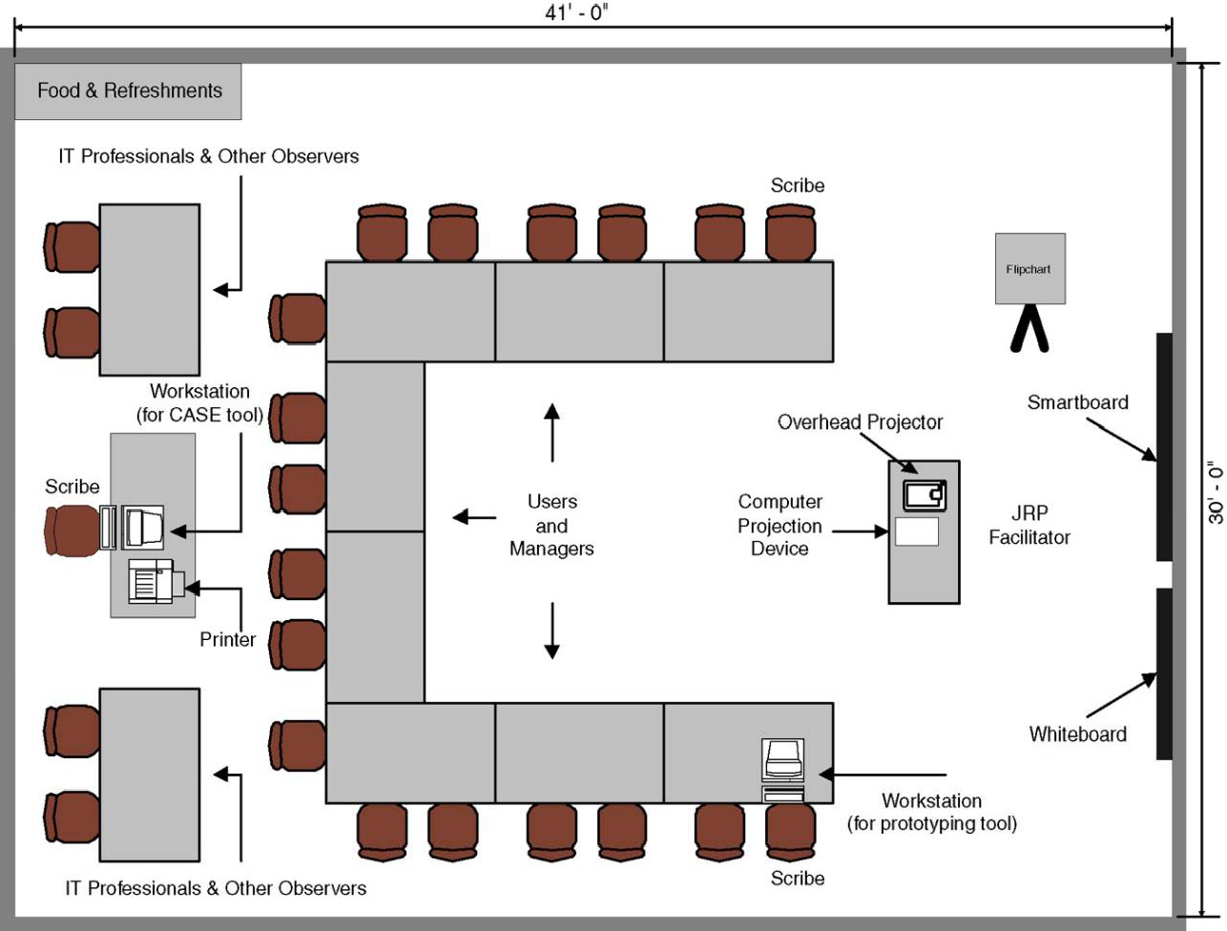
Typical room layout for JRP session

Slide 44
Brainstorming
Sometimes, one of the goals of a JRP session is to generate possible ideas to solve a problem.
– Brainstorming is a common approach that is used for this purpose.
Brainstorming – a technique for generating ideas by encouraging participants to offer as many ideas as possible in a short period of time without any analysis until all the ideas have been exhausted.

Slide 45
Brainstorming Guidelines
Isolate the appropriate people in a place that will be free from distractions and interruptions.
Make sure everyone understands the purpose of the meeting.
Appoint one person to record ideas.
Remind everyone of brainstorming rules.
Within a specified time period, team members call out their ideas as quickly as they can think of them.
After the group has run out of ideas and all ideas have been recorded, then and only then should the ideas be analyzed and evaluated.
Refine, combine, and improve the ideas that were generated earlier.

Slide 46
Benefits of JRP
JRP actively involves users and management in the development project (encouraging them to take “ownership” in the project).
JRP reduces the amount of time required to develop systems.
When JRP incorporates prototyping as a means for confirming requirements and obtaining design approvals, the benefits of prototyping are realized

Slide 47
A Complete Fact‐Finding Strategy
Learn from existing documents, forms, reports, and files.
If appropriate, observe the system in action.
Given all the facts that already collected, design and distribute questionnaires to clear up things that aren’t fully understood.
Conduct interviews (or group work sessions).
(Optional). Build discovery prototypes for any functional requirements that are not understood or for requirements that need to be validated.
Follow up to verify facts.

Slide 48
The PIECES Problem‐Solving Framework
P the need to improve performance
I the need to improve information (and data)
E the need to improve economics, control costs, or increase profits
C the need to improve control or security
E the need to improve efficiency of people and processes
S the need to improve service to customers, suppliers, partners, employees, etc.
55

Slide 49
Reference
System Analysis and Design methods – Whitten
– Chapter 6

Slide 50
Thank You & Questions

